Slide 1
Feature Detection

Slide 2
Feature (computer vision)
In computer vision and image processing, a feature is a piece of information about the content of an image;
typically about whether a certain region of the image has certain properties.
Features may be specific structures in the image such as points, edges or objects.
A feature is a significant piece of information extracted from an image which provides more detailed understanding of the image.

Slide 3
What is “Image Processing and Computer Vision”?
Image Processing
manipulate image data
generate another image
Computer Vision
process image data
generate symbolic data

Slide 4
A picture is worth more than a thousand words
Image processing & computer vision plays an important role in society today because
A picture gives a much clearer impression of a situation or an object
Having an accurate visual perspective of things has a high social, technical and economic value

Slide 5
Digital image perception is used for:
Improving pictorial information for human perception
Processing of image data for storage, transmission and representation for autonomous machine perception.

Slide 6
Image Processing
Image Processing is to perform numerical operations on higher dimensional signals such as images and video sequences.
The objectives of image processing include:
Improving the appearance of the visual data
image enhancement, image restoration
Extracting useful information
image analysis, reconstruction from projection
Representing the image in an alternate and possibly more efficient form
transformation, image compression

Slide 7
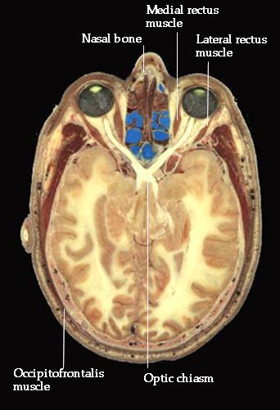
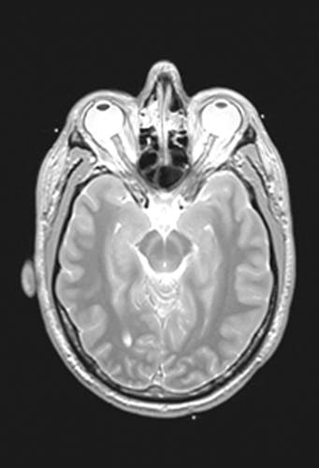
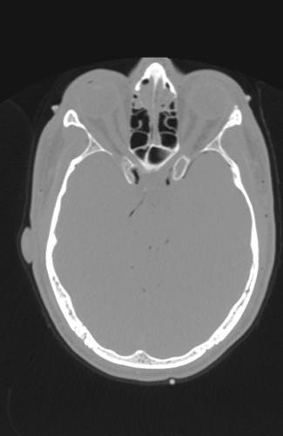
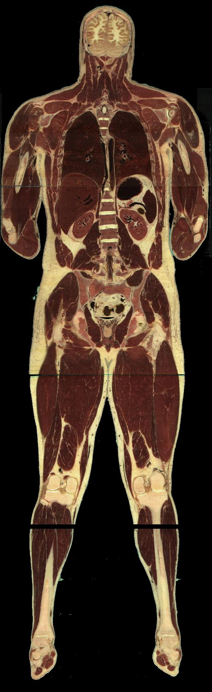
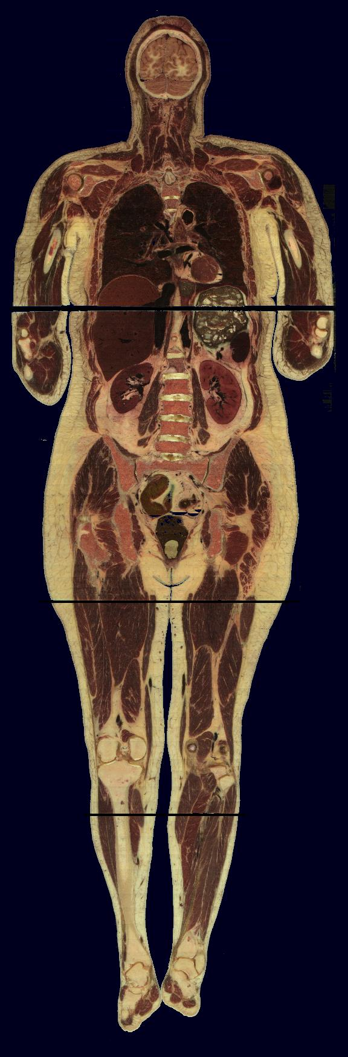
Visible Human Project
Photo
MRI
CT

Slide 8
The field of digital image processing refers to processing digital images by means of a digital computer. A digital image composes of a finite number of elements which have a particular location and value and these elements are referred to as picture elements, image elements, pels and pixels.
Digital Image: a two dimensional array of pixels.
Size (or resolution) of an image:
width: N pixels, height: M pixels.
Precision of pixels:
2^{n} amplitude levels ⇒ n bits per pixel.
Overall data file size: N × M × n bits

Slide 9
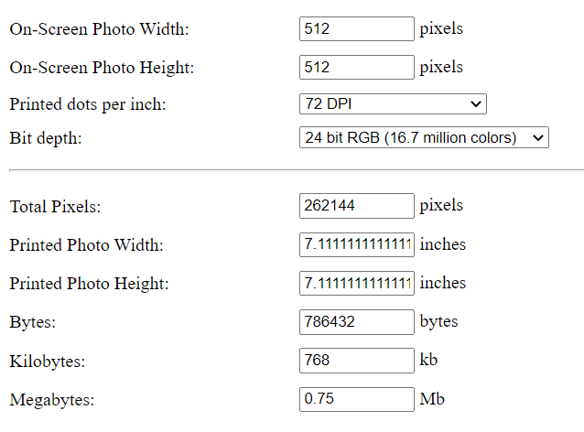

Image Example
Images are referred to more than just the projections generated by the visual band of the EM (electromagnetic) waves apparent to humans
LENA, 512x512, true color (24 b/p), 786432 bytes.

Slide 10
Image analysis
Image analysis is to identify and extract useful information from an image or a video scene, typically with the ultimate goal of forming a decision.
Image analysis is the center piece of many applications such as remote sensing, robotic vision and medical imaging.
Image analysis generally involves basic operations:
Pre-processing,
Object representation,
Feature detection,
Classification and interpretation.

Slide 11
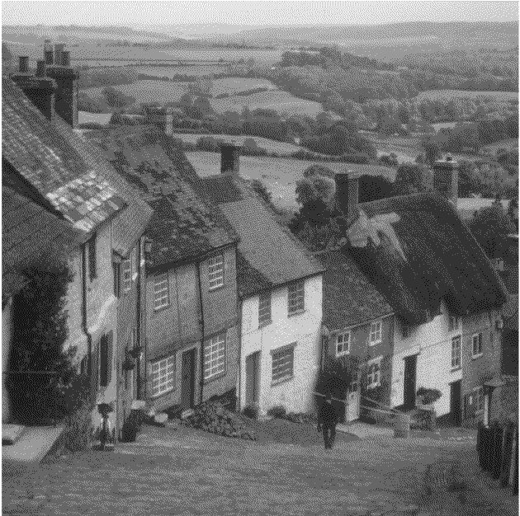
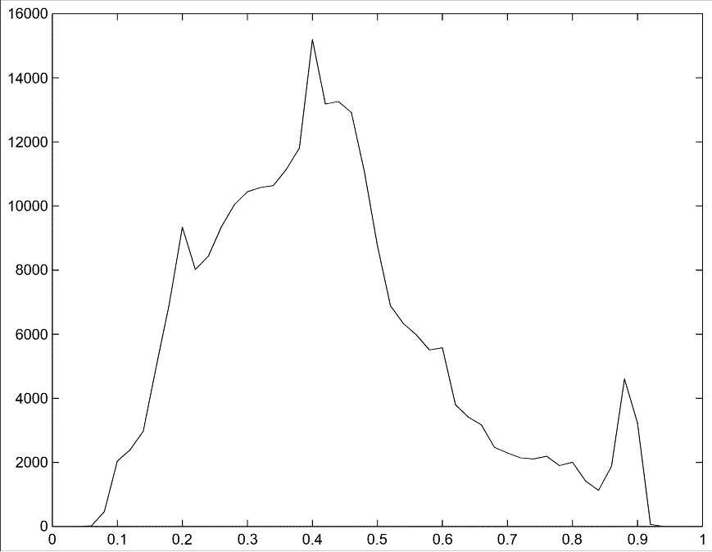
Histogram Example
Original

Slide 12
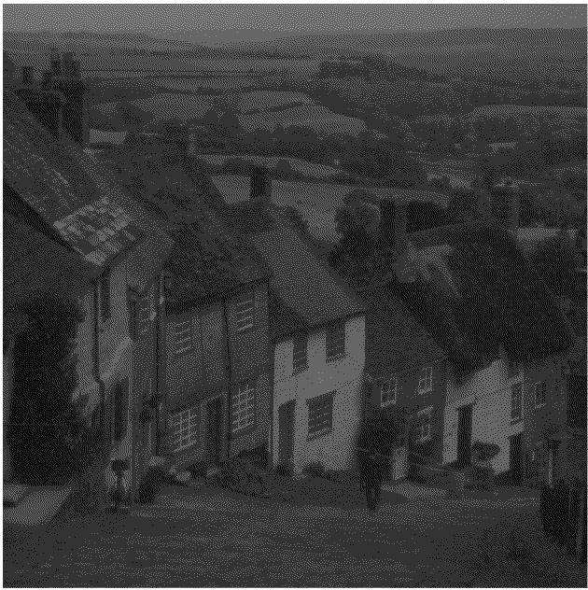
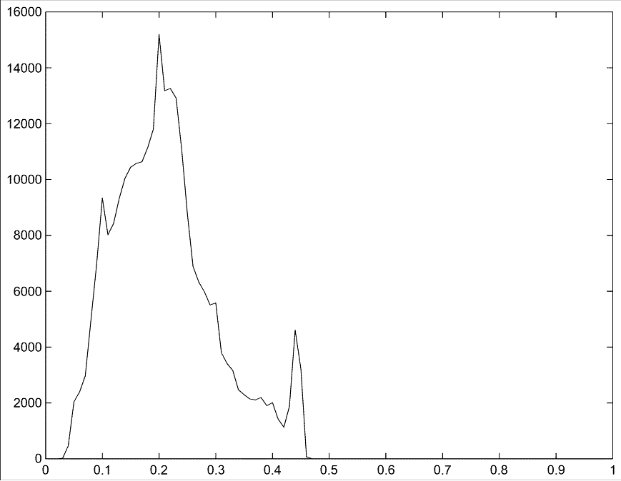
Histogram Example (cont. )
Poor contrast

Slide 13
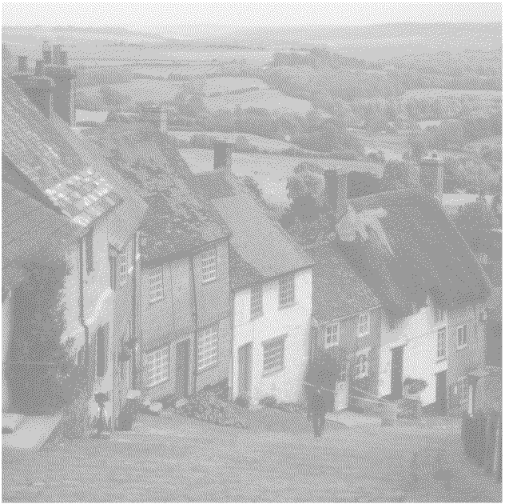
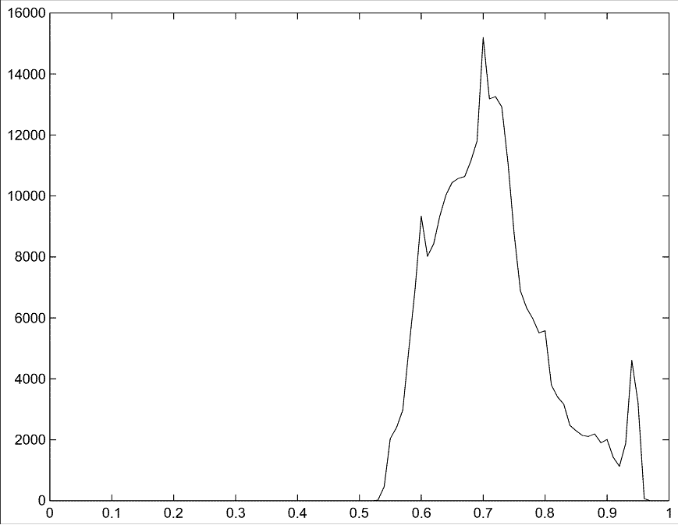
Histogram Example (cont. )
Poor contrast

Slide 14
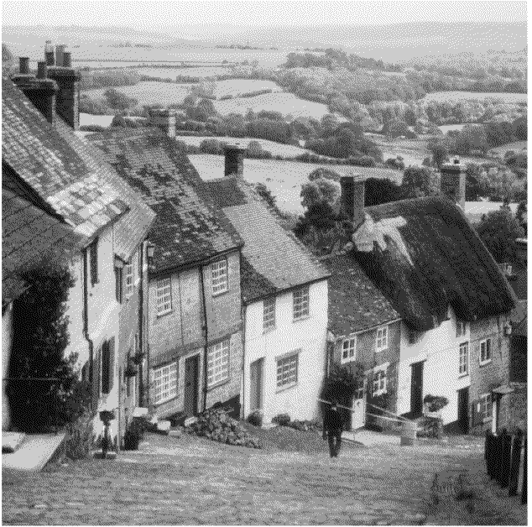
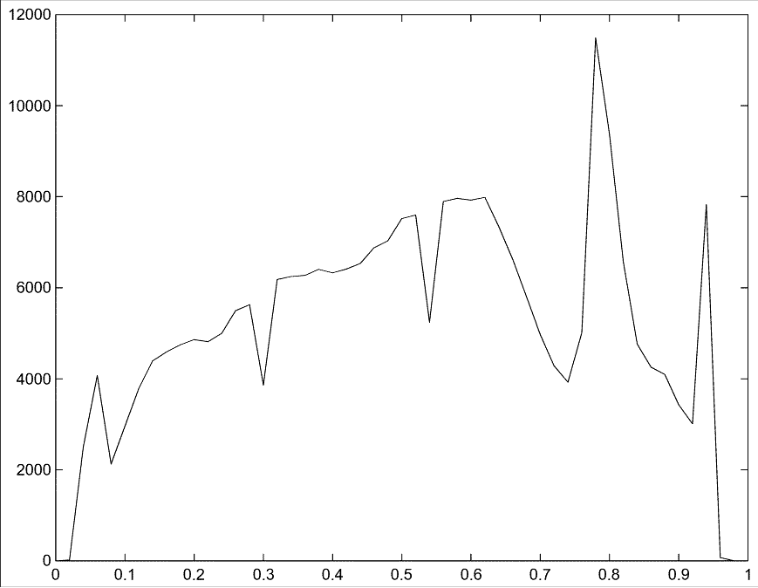
Histogram Example (cont. )
Enhanced contrast

Slide 15
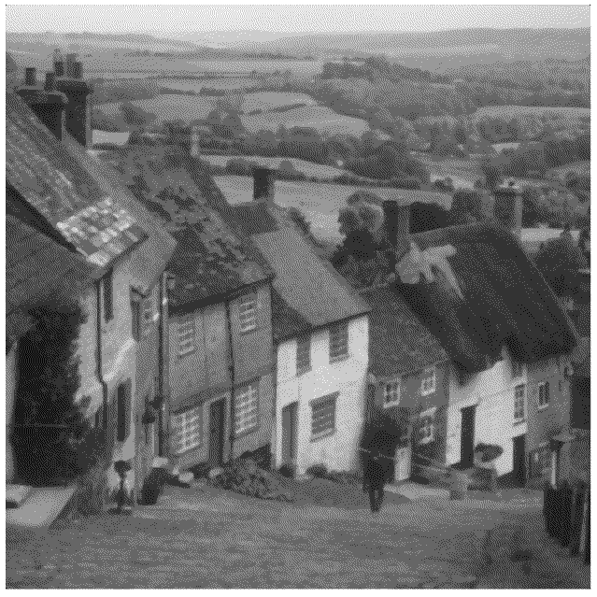
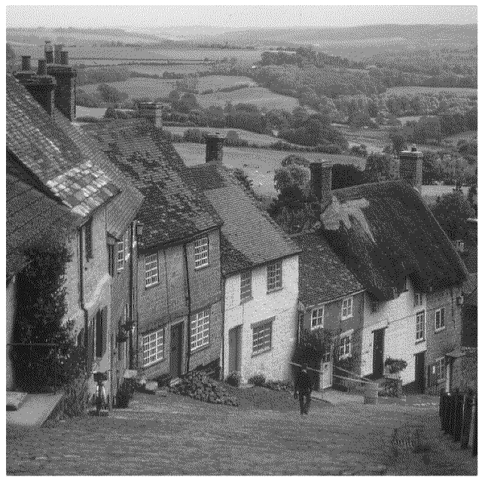
Smoothing and Sharpening Examples
Smoothing
Sharpening

Slide 16
Smoothing and Sharpening Examples
Smoothing
Sharpening

Slide 17

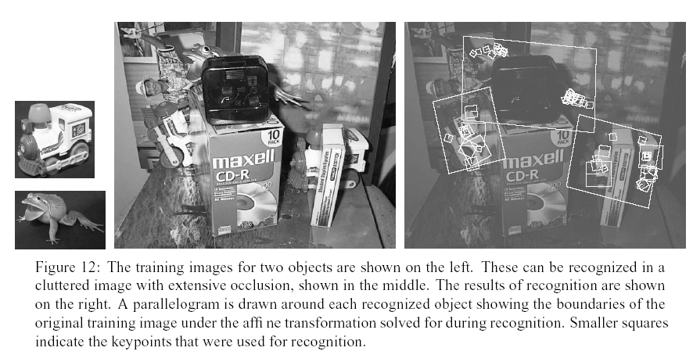
Finding the “same” thing across images
Categories
Find a bottle:
Instances
Find these two objects
Can’t do
unless you do not care about few errors…
Can nail it

Slide 18
Finding the “same” thing across images

Slide 19
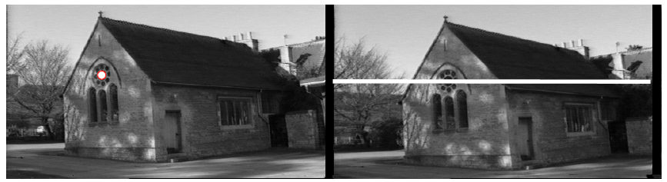
But where is that point?

Slide 20













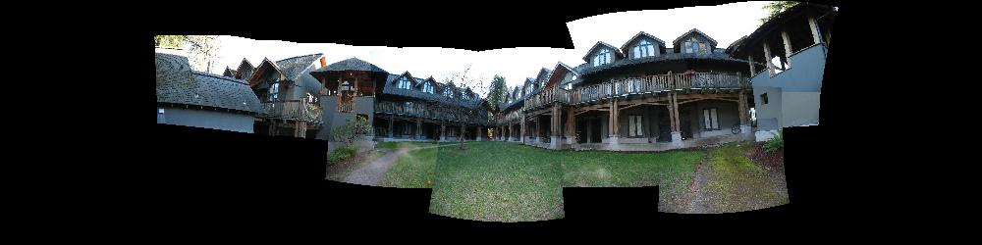
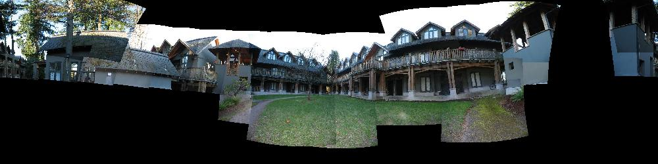
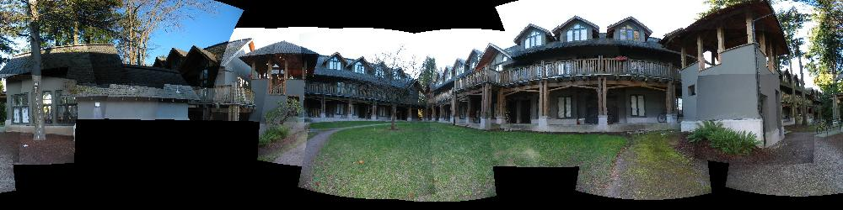
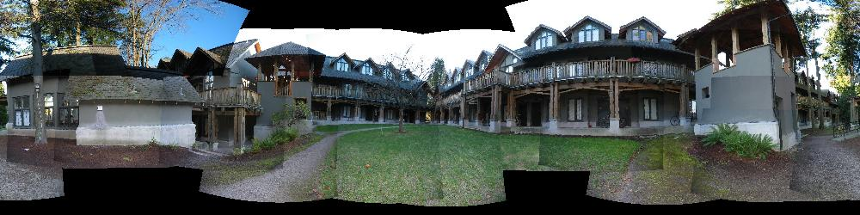
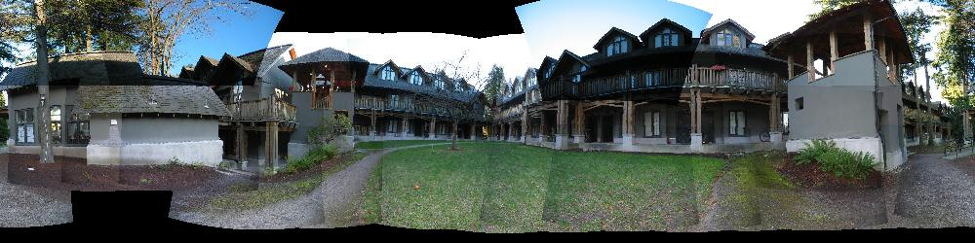
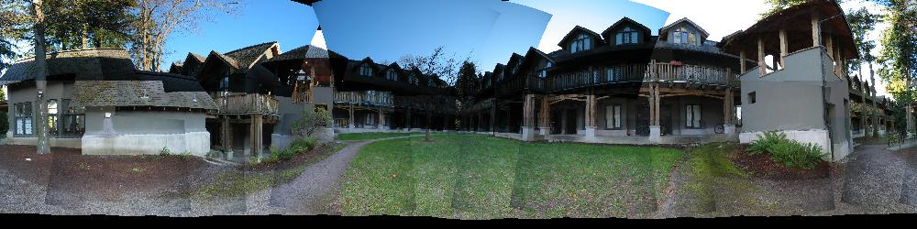
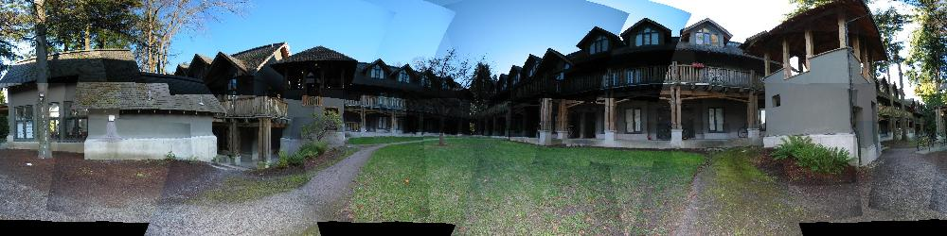
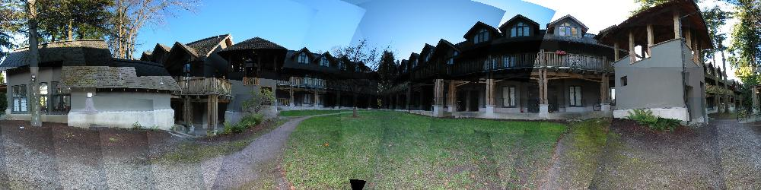

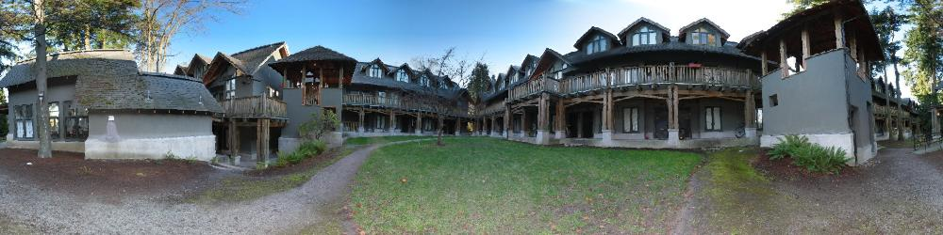
Building a Panorama
M. Brown and D. G. Lowe. Recognising Panoramas. ICCV 2003

Slide 21
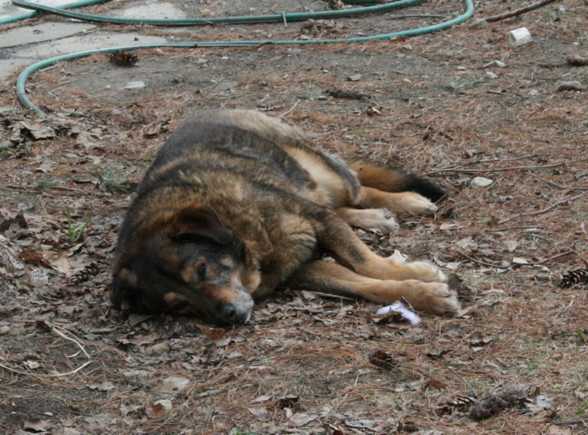
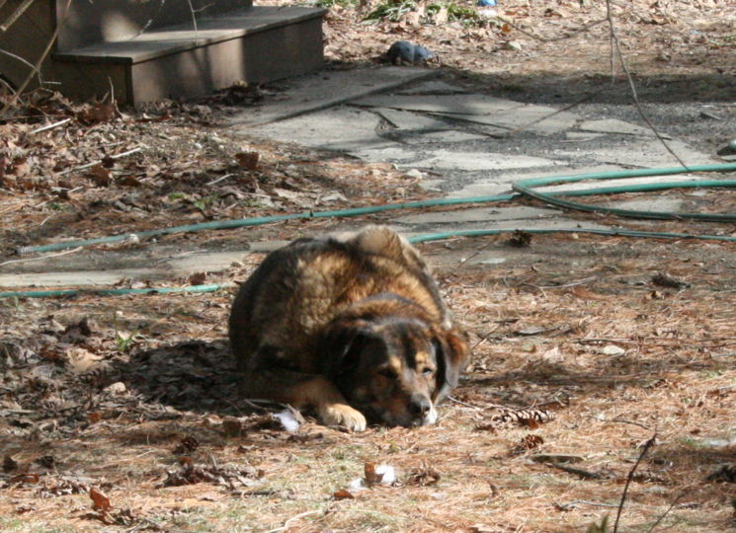
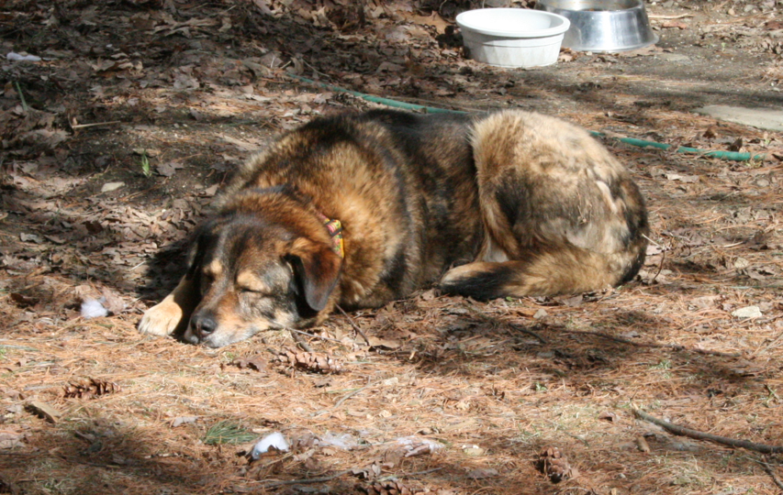


Slide 22
Uses for feature point detectors and descriptors in computer vision and graphics.
Image alignment and building panoramas
3D reconstruction
Motion tracking
Object recognition
Indexing and database retrieval
Robot navigation
… other

Slide 23


How do we build a panorama?
We need to match (align) images

Slide 24


Matching with Features
Detect feature points in both images

Slide 25
Matching with Features
Detect feature points in both images
Find corresponding pairs

Slide 26

Matching with Features
Detect feature points in both images
Find corresponding pairs
Use these matching pairs to align images - the required mapping is called a homography.

Slide 27
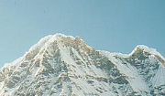
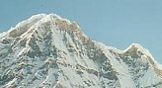
Matching with Features
Problem 1:
Detect the same point independently in both images
counter-example:
no chance to match!
We need a repeatable detector

Slide 28
Matching with Features
Problem 2:
For each point correctly recognize the corresponding one
?
We need a reliable and distinctive descriptor

Slide 29
Building a Panorama
M. Brown and D. G. Lowe. Recognising Panoramas. ICCV 2003

Slide 30
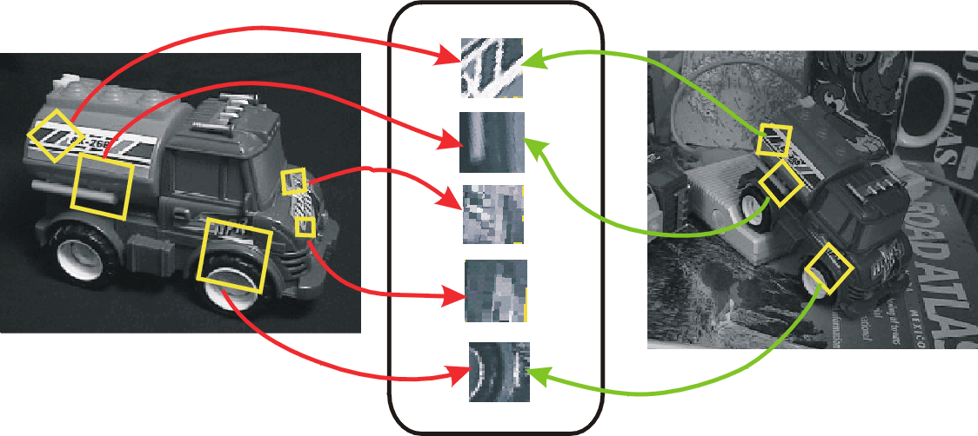
Preview
Detector: detect same scene points independently in both images
Descriptor: encode local neighboring window
Note how scale & rotation of window are the same in both image (but computed independently)
Correspondence: find most similar descriptor in other image
detector location
Note: here viewpoint is different, not panorama (they show off)
Descriptor

Slide 31
Thank You

